Slide 1

Surprising Ways to Offend People in other Countries
What SOCIAL STYLEs® are and why they are important
Benefits of using SOCIAL STYLEs
MODULE five Cultures and personal styles
1
Notes:
Duration: 1 minute
Facilitator Notes: This slide lists the topics to be covered in module four.
DO:
Read the content on the slide.
Explain:
In this module, we will look at how cultural differences can impact everyday communication. We will also take a look at SOCIAL STYLEs and how an understanding of them can help us communicate with other more effectively.
Transition:
Let us begin this module with a fun activity.

Slide 2
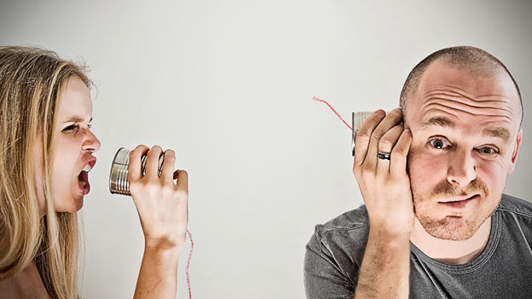
What have some of your cross-cultural communication blunders or misunderstandings been? Share your story.
People from different parts of the world naturally have communications styles specific to their own culture.
In a global company such as Accenture, multicultural teams are the norm.
It’s important to understand how people from different cultures communicate so that you can learn to successfully work together and eliminate any barriers.
Copyright © 2017 Accenture. All rights reserved. For Accenture Internal Use Only.
2
Notes:
Duration: 2 minutes
Facilitator Notes: This is a quick open discussion to highlight the importance of understanding cultural differences and being sensitive about these differences when interacting with others at work.
 Do:
Display the question on the slide and elicit responses from the participants.
Ask them, in their scenario, what could they have done differently now that they have explored different communication tools and techniques.
Use the points on the slide to emphasize on the aspect that it’s important to understand how people from different cultures communicate so that you can learn to successfully work together and eliminate any barriers.
Transition:
To understand and be able to respond appropriately across different cultures, one definitely needs to be aware of cultural nuances. Additionally though, what one could definitely leverage is knowing one’s own communication style and that of others as well. How do we do this? Well simply by understanding ours and their SOCIAL STYLEs. I hope you’ve completed the pre-work of taking the one hour WBT on Social Styles on myLearning.

Slide 3
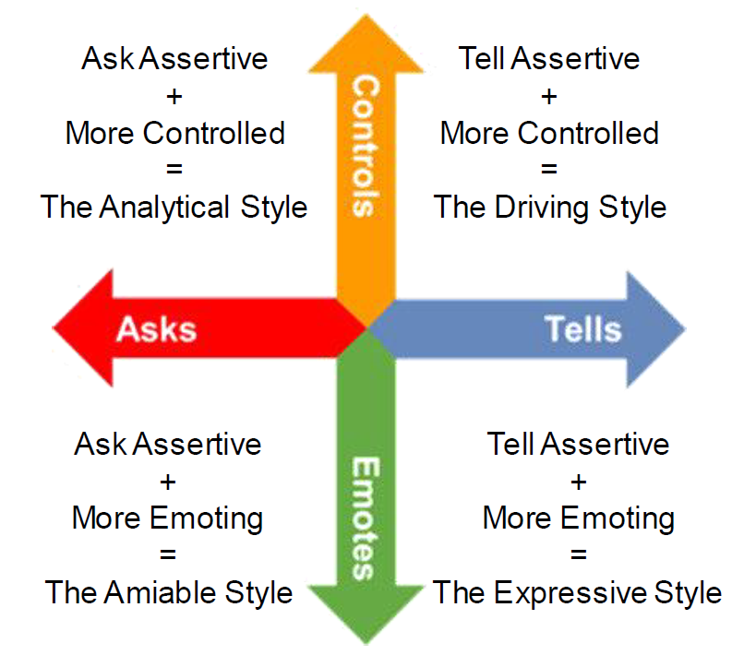
SOCIAL STYLES
Social Styles is a framework for observing, understanding, and anticipating an individual’s behaviour.
3
Notes:
Duration: 5 minutes
Facilitator Notes: This slide introduces the participants to SOCIAL STYLEs.
Do:
State that knowing the Social Style of the others helps in understanding how they will respond to a new idea/proposal.
Explain Social Style Model using the talking points provided below.
Explain:
The SOCIAL STYLE Model™ is based on the observation and measurement of Assertiveness and Responsiveness that are independent of each other. It's important to understand that these two dimensions, or scales, are independent of one another, and they are each neutral. That is, there is no good or bad place, or positive or negative place, to be on these scales. What is important is how appropriate your behaviors are to the person to whom you are responding, and the situation.
When we refer to a SOCIAL STYLE, we are not referring to a person's personality, but rather those behaviors that we can see, discuss, and agree upon. Behaviors, for this course, are the things people say and things people do—verbal and nonverbal behaviors. For example, you can hear when people talk fast or slow, speak in a monotone, or have a lot of inflections in their voice. You can also see a person leaning forward in anticipation or leaning back, reflecting on what you've said. They can be animated, having a lot of hand and body gestures, or they may be stiff, with little or no body movement.
The two scales, Assertiveness and Responsiveness, combine to form a picture of observable actions. The Assertiveness scale is placed along the horizontal axis, and the Responsiveness scale is placed along the vertical axis, thus forming four quadrants.
Assertiveness measures the degree to which others perceive a person as tending to ask or tell in interactions with others. The two descriptive anchors for the assertiveness scale are Ask Assertive and Tell Assertive.
Continued on next page

Slide 4
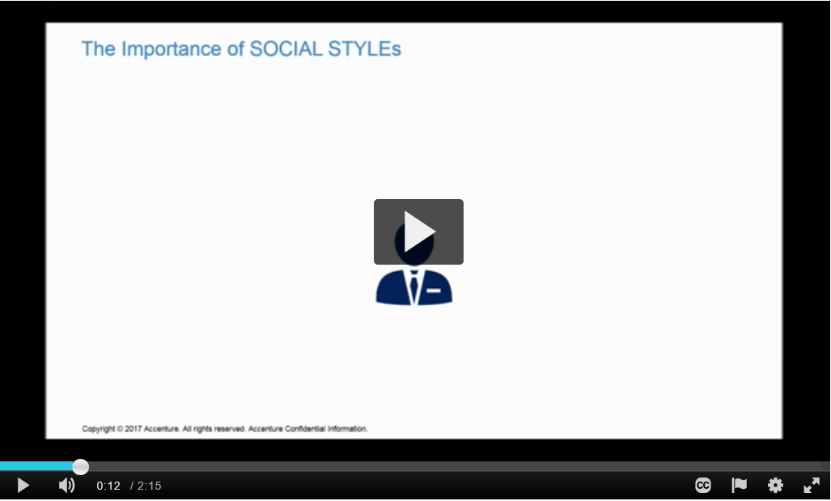
THE IMPORTANCE OF SOCIAL STYLES
How does an understanding of SOCIAL STYLEs help us?
4
Notes:
Duration: 5 minutes
Facilitator Notes: This video highlights the importance of SOCIAL STYLEs.
 Do:
Play the video either using the embedded link on the slide or alternatively use the following Knowledge Exchange Link: httpshttps://mediaexchange.accenture.com/media/t/1_nyo2u8hj/52129841
Once you’ve played the video, ask the participants “how does an understanding of SOCIAL STYLEs help each one of us”
Elicit responses from all and use the next slide to talk more about how an understanding of SOCIAL STYLEs helps build relationships.
Transition:
Understanding SOCIAL STYLEs can help you be more versatile in your interactions with others.

Slide 5




Understanding SOCIAL STYLES
ANALYTICAL
Logical
Data and Detail
Process / Methods
Accuracy
Contemplative
DRIVER
Organized
Values facts and figures
Emphasizes on now
Controlling
Understanding SOCIAL STYLEs can help you be more versatile in your interactions with others.
AMIABLE
Emotional
Wants Harmony
People-oriented
Credibility
Risk averse
EXPRESSIVE
Forward looking
Values opinions
Innovative
Risk taker
Impulsive
5
Notes:
Duration: 2 minutes
Facilitator Notes: Use this slide to debrief the discussion carried out after watching the video.
Explain:
The whole point of learning about Style and versatility is to increase interpersonal effectiveness.
Versatility is the ability to manage tension in relationships, and to be interpersonally effective. The higher one’s versatility, the more concern placed on others’ tension versus one’s own tension. Versatility can be learned. People consciously and subconsciously observe and evaluate each other’s behavior as they interact.
Relationships deteriorate when Style-related behaviors jeopardize the productivity of the relationship.
Interactions should focus on ways that make others comfortable and help them meet their Style-specific needs.
Through Style awareness, we understand how to interact with people in ways that make them comfortable and help them meet their Style-specific needs. Inevitably, this leads to higher productivity.
To make other persons feel more comfortable, tailor your behavior and communications to their SOCIAL STYLE. This versatility in your behavior determines how others will view your ability and skillfulness at adapting to many different types of people in a variety of situations:
Transition:
So what are the benefits of using SOCIAL STYLEs?

Slide 6

Benefits of using Social Styles
Strengthen relationships
Improve communication
Help predict behaviors that give us strong indications of others values
Enable us to craft compelling messages
Give us insight into how others make decisions
Improves our odds of winning opportunities
Copyright © 2017 Accenture. All rights reserved. For Accenture Internal Use Only.
6
Notes:
Duration: 2 minutes
Facilitator Notes: Use this slide to summarize the benefits of using SOCIAL STYLEs.
Transition:
We have looked at cultural differences and understood SOCIAL STYLEs.

Slide 7

Questions around the table?
Copyright © 2017 Accenture. All rights reserved. For Accenture Internal Use Only.
7
Notes:
Duration:
Transition:
This brings us to the end of Module Five. Does anyone have any questions on what we have covered so far? (Answer if anyone has any questions.)
Let’s spend some time practicing the scenarios you have.

Slide 8
Skills Practice session – practice your scenarios
Some more roleplays
MODULE SIX skills pRACTICE SESSION
8
Notes:
Duration: 1 minute
Facilitator Notes: This is the introductory slide to the last module which is the skills practice session.
Explain:
This last module is all about getting as much practice as we can with all that we’ve covered these past two days. We had decided to work on some scenarios and bring them to this session. We will use those scenarios to practice. Post that, if we do have some time, we will also practice some more role plays.
Transition:
Let’s get started!

Slide 9

Practice scenarios
Briefing time: 5 minutes
Explain to your partner and observers:
Which style you want to practice and what you would like feedback on
Which role play you have chosen; any additional partner instructions
Skills practice time: 10-15 minutes (5 minutes each scenario)
Execute the role play
Practice at least twice! Pause, feedback, repeat, try again, etc…
Feedback: 2 minutes (per roleplay)
‘Practicer’ first
Partner (‘the one being practiced on’) next
Observer
Copyright © 2017 Accenture. All rights reserved. For Accenture Internal Use Only.
9
Notes:
Duration: 30 minutes
Facilitator Notes: This is the introductory slide to the last module which is the skills practice session.
 Do:
Divide the participants into smaller groups of four.
Have them practice at least two scenarios that they may have brought with them.
Set context that while two or three people are roleplaying, at least one person must play the role of an observer and take notes on how the others play their roles.
Transition:
Let’s get started!

Slide 10

NOTES FOR
OBSERVER(S)
Watch, listen, and take notes on the following points:
How well are they…?
Sharing the conversation?
Listening and attempting to learn about the other person before sharing opinions?
Keeping it simple – talking and conversing not lecturing or presenting?
Giving and receiving support?
Note examples of powerful questions, honesty, openness, courageous talk, and constructive candor.
Copyright © 2017 Accenture. All rights reserved. For Accenture Internal Use Only.
10
Notes:
Duration: 2 minutes
Facilitator Notes: Continue to have the participants work in their groups. If you sense they could use a change in partners, quickly regroup the teams. If you have a small group of 10 participants then you can have two participants come up in front to roleplay and have the other play as observers. If you have a large group, ensure you split them into smaller groups of four or five and have them work in their groups where two will roleplay and the others will be observers.
 Do:
Instruct the participants that they will be provided scenarios and will need to work in their groups the same way they did so far where two people role played while the others observed and provided feedback.
Then mouse click to reveal the notes for the observers.
Instruct the groups that they will take turns to play the role of the observers so it is imperative that everyone understands the ask from the observers.
Transition:
Let’s look at the first scenario

Slide 11
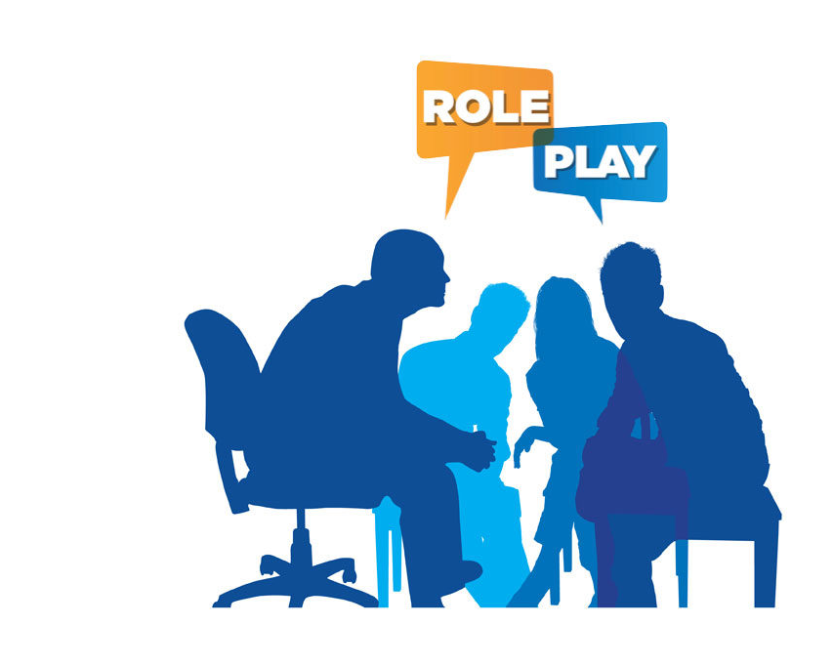
Role play I
Abhay has been leading a team for two months. As the project/phase of work has moved forward, Abhay has noticed less cooperation and input from the client/customer team members. Currently, the client/customer team is running behind schedule on completing the deliverables they have been assigned. Through observations and specific reports, Abhay has discovered that the Accenture team members are working significantly longer hours to compensate for their client/customer teammates. Abhay is concerned about the client/customer relationship ramifications, specifically what it would mean to confront the client/customer about meeting their target dates. Abhay is also concerned about attaining the overall project’s goals and the impact on Accenture team members’ morale. Abhay has set up a meeting with Ramona, his counterpart at the client/customer.
11
Notes:
Duration: 7 minutes
Facilitator Notes: This is one of the role plays you can have the participants practice.
 Do:
Divide the group into smaller teams of four or five. Have them:
Decide who will “play” Ramona, Abhay and who will serve as observer.
With Abhay opening the conversation, role-play for approximately 5 minutes.

Slide 12

debrief
What went well?
What didn’t go well?
What new knowledge or skills do you need to develop?
Copyright © 2017 Accenture. All rights reserved. For Accenture Internal Use Only.
12
Notes:
Duration: 3 minutes
Facilitator Notes: Use this slide to carry out the debrief session. This could also work as a feedback session where the observers respond to the questions placed on the slide based on their observations. Run this as a Rose/Thorn/Bud exercise using pink/blue/green post-its. Have the observers provide feedback by writing on the post-its. Instruct the participants that they are only to listen to the feedback and are not expected to justify or respond to it. Instruct the participants providing feedback that this is a learning opportunity for all and therefore the feedback they provide must be honest and developmental in nature and not condescending by any means.
Explain:
This is an opportunity for us to learn from our experiences. We will share feedback on (read questions on the slide):
What went well?
What didn’t go well?
What new knowledge or skills do you need to develop?
Note: Make sure you return to this slide after every scenario is acted for a quick debrief.

Slide 13
Role play II
Nguyen, a very conscientious and knowledgeable team member, is working on a report that you used to complete. Peter got her get started, made sure she understood the requirements, and left her on her own to complete the report, which is due the following week. Their manager has requested that the report be sent to the Sponsor as soon as possible. Given the change in deadline and the fact that it is Nguyen’s first time working on the report, Peter is wondering what to do. Should he offer to take the responsibility back – just this one time or see just see how Nguyen wants to handle it? Peter has set up a call with Nguyen to let her know about the earlier due date and to discuss the situation.
13
Notes:
Duration: 7 minutes
Facilitator Notes: This is one of the role plays you can have the participants practice.
 Do:
Divide the group into smaller teams of four or five. Have them:
Decide who will “play” Nguyen, Peter and who will serve as observer.
With Peter opening the conversation, role-play for approximately 5 minutes.

Slide 14
Role play III
Rita and Sam are colleagues who are working together on an assignment which needs to be finished tomorrow. Sam has been very absent these last days and not contributed much. Rita is anxious to get the job done, but can’t do it alone. Rita’s ultimate goal is to get going together again to meet the deadline. To reach that goal Rita will somehow first have to understand more about Sam’s situation, by showing empathy.
14
Notes:
Duration: 7 minutes
Facilitator Notes: This is one of the role plays you can have the participants practice.
 Do:
Divide the group into smaller teams of four or five. Have them:
Decide who will “play” Sam, Rita and who will serve as observer.
With Rita opening the conversation, role-play for approximately 5 minutes.

Slide 15
Role play IV
Felicia by nature is modest and doesn’t voice her opinion quickly. When she does speak, she actually has quite good points. Her counterpart on this project, Neil, is known for his seemingly endless streams of words, and taking over the conversation. It is really important that Felicia gets enough room to speak, so that she can tell him what she think of the project approach.
15
Notes:
Duration: 7 minutes
Facilitator Notes: This is one of the role plays you can have the participants practice.
 Do:
Divide the group into smaller teams of four or five. Have them:
Decide who will “play” Felicia, Neil and who will serve as observer.
With Neil opening the conversation, role-play for approximately 5 minutes.

Slide 16
Role play V
Zack works on a large system implementation project. The Go-Live week of your project has been delayed for the third time. This is the second time his manager Raffaele has asked to move his holiday for the sake of the Go-Live week. Zack is determined to stick to his holiday plans this time, mainly because he is concerned for the consequences to his relationship with his girlfriend/wife.
16
Notes:
Duration: 7 minutes
Facilitator Notes: This is one of the role plays you can have the participants practice.
 Do:
Divide the group into smaller teams of four or five. Have them:
Decide who will “play” Zack, Raffaele and who will serve as observer.
With Raffaele opening the conversation, role-play for approximately 5 minutes.

Slide 17
Role play VI
Arnold meets his manager Chris in the hallway and wants to notify him of an issue on the project which is comprising the deadline.
Background of the situation:
The team is working hard to finish the functional designs before the deadline
The client is lacking cooperation in Arnold’s project team
Jennifer on Arnold’s team (ACN side) has been ill for a week
The client team member is challenging the requirements, which they claim have not been signed off
Chris is a busy man and he places high value on keeping messages short.
17
Notes:
Duration: 7 minutes
Facilitator Notes: This is one of the role plays you can have the participants practice.
 Do:
Divide the group into smaller teams of four or five. Have them:
Decide who will “play” Arnold, Chris and who will serve as observer.
With Raffaele opening the conversation, role-play for approximately 5 minutes.

Slide 18

Just breathe…
Copyright © 2017 Accenture. All rights reserved. For Accenture Internal Use Only.
18
Notes:
Duration: 2 minutes
Facilitator Notes:
This is a quick 2 minute breathing exercise recommended to help destress everyone.
DO:
Instruct everyone to put aside everything that they are doing and just place their palms facing downwards on their laps. They can sit wherever they are.
Instruct them to sit in an upright position with their eyes closed and their hands on their lap.
Instruct them to breathe normally and observe their breath. Ask them to just declutter their mind and channel their entire focus on their breath as they inhale and exhale.
Instruct them to breathe in, hold for 5 seconds and breathe out. Repeat this instruction three to six times depending on the group’s restlessness levels – if the group is restless, have repeat the breathing technique till the seem relaxed.
Instruct them to keep their eyes closed and gently rub their palms and place them on their eyes.
Instruct them to open their eyes gently.
Transition:
I hope you feel a little light and relaxed. Now that we’ve brought all that focus back on to us, let’s spend a few minutes to reflect on all that we’ve learned and practiced these past two days.

Slide 19
SUMMING IT UP
What are some of the best practices you are taking away with you ?
Are there any distinct communication styles that you were able to pick out from the room?
What are your own areas for development?
Are you now better equipped to handle tough situations?
19
Notes:
Duration: 3 minutes
Facilitator Notes: Use this slide to carry out a final debrief of the entire two day workshop. Go back to the questions participants had and see if they have been answered.
Explain:
Effective and Structured Communication is progressive process; you build on it everyday with the myriad interactions you have. What is critical is that you take time to reflect and relook and how you can do things differently and then go ahead and implement those change. Come back to us if you have any questions or have any best practices you would like to share with us.
Should you like to read more, go to the Professional Development Collections site – it has a plethora of learning solutions you can pick and use to further build on your skills.
Transition:
And on that note, I’d like to thank you for taking time to attend this two-day workshop. I hope you enjoyed it as much as I did and you walk out today feeling more confident. (move to the Thank you note on the next slide)

Slide 20
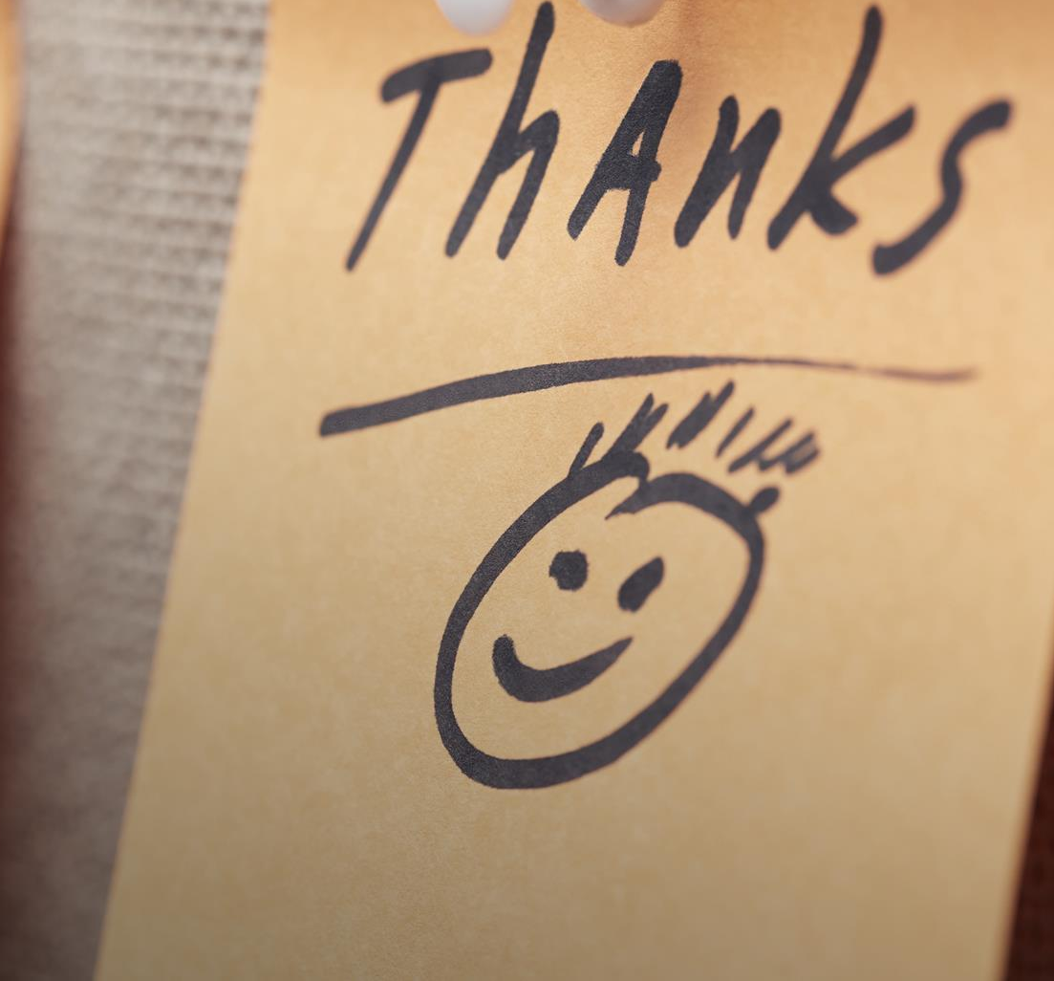
Please share your feedback via myLearning and let us know how this course was for you. Your feedback will go a long way in ensuring we provide the best support and enable you to be your best at work!
Copyright © 2017 Accenture. All rights reserved. For Accenture Internal Use Only.
20

